Slide 1

Natural Language Processing DLO 8012
Subject In-charge
Ms Vincy Joseph
Assistant Professor
email: vincyjoseph@sfit.ac.in

Slide 2
Module VI
Lecture 33 Applications of NLP

Slide 3
Machine Translation

Slide 4
Approaches to Machine Translation
MT is classified into seven broad categories:
rule-based
knowledge-based
principle-based
statistical-based
hybrid-based
example-based
online interactive based methods.

Slide 5
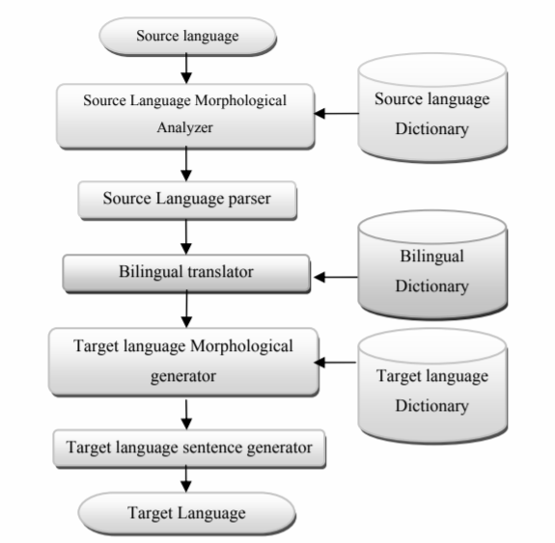
RBMT System
RBMT generates the target text given a source text in the following the steps

Slide 6
Information Retrieval System

Slide 7
Information Retrieval
IR deals with the representation, storage, and access of information and is concerned with the organization and retrieval of information from large database collections.

Slide 8
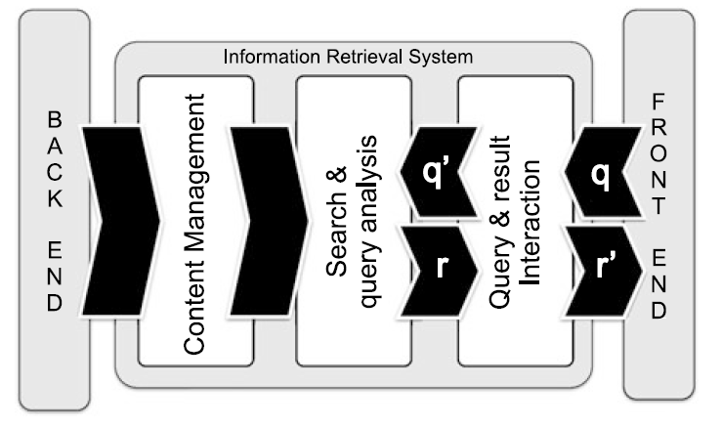
Information Retrieval System

Slide 9
Information Retrieval
Here, the user issues a query q from the front-end application
q is processed by a query interaction module that transforms it into a “machine-readable” query q’
q‘ is fed into a search and query analysis module.
It has access to the content management module directly linked with the back-end information source (e.g., a database).

Slide 10
Information Retrieval
Once a set of results r is made ready by the search module, it is returned to the user via the result interaction module
Optionally, the result is modified (into r ) or updated until the user is completely satisfied.

Slide 11
Information Retrieval
The most widespread applications of IR are the ones dealing with textual data.
As textual IR deals with document sources and questions expressed in natural language
The processing of textual queries typically performed by an IR engine are shown in figure.

Slide 12
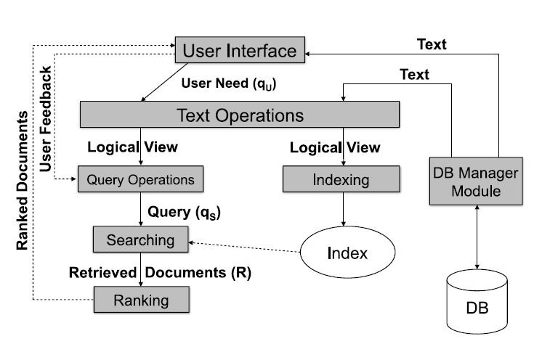
Information Retrieval : Text

Slide 13
Information Retrieval : Text
1. The user need is specified via the user interface, in the form of a textual query q_{U} (made of keywords).
2. The query q_{U} is parsed and transformed by a set of textual operations (the same operations have been previously applied to the contents indexed by the IR system). This step yields a refined query q’_{U} .
3. Then query is transformed into a system-level representation, q_{S} .

Slide 14
Information Retrieval : Text
4. The query q_{S} is executed on top of a document source D to retrieve a set of relevant documents, R.
5. The set of retrieved documents R is then ordered: documents are ranked according to the estimated relevance.
6. The user then examines the set of ranked documents for useful information and provide feedback to the system.

Slide 15
Text Processing in IR
Not all words are equally effective for the representation of a document’s semantics.
Noun words (words or noun phrase groups) are the most representative components.
Based on this observation, IR system also preprocesses the text of the documents to determine the most “important” terms to be used as index terms

Slide 16
Text Processing in IR
When selecting candidate keywords, indexing must fulfill two different and potentially opposite goals:
Exhaustiveness : assign sufficient terms to a document
Specificity : the exclusion of generic terms that carry little semantics.
Generic terms : (conjunctions and prepositions) are characterized by a low discriminative power as their frequency across any document in the collection tends to be high.

Slide 17
Text Processing in IR
Generic terms have high term frequency, defined as the number of occurrences of the term in a document.
Specific terms have higher discriminative power, due to their rare occurrences across collection documents: they have low document frequency.

Slide 18
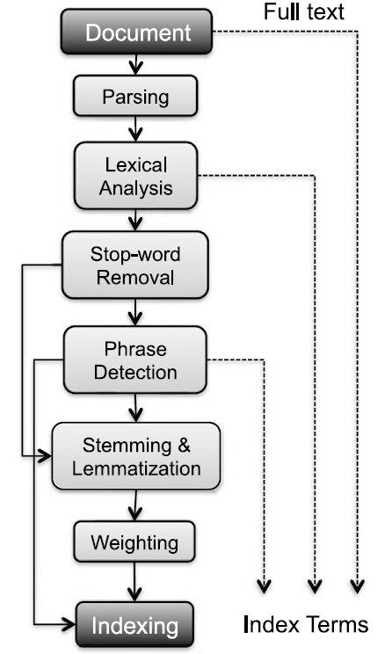
Textual Operations
The textual preprocessing phase typically performed by an IR engine, takes as input a document and yields its index terms as output.
The process of this extraction is given in the figure.

Slide 19
1. Document Parsing.
Documents come in all sorts of languages, character sets, and formats and the same document may contain multiple languages or formats.
e.g. A French email with Portuguese PDF attachments.
Document parsing deals with the recognition and “breaking down” of the document structure into individual components.
In this preprocessing phase, unit documents are created;
e.g., emails with attachments are split into one document representing the email and as many documents as there are attachments.

Slide 20
2. Lexical Analysis.
After parsing, lexical analysis tokenizes a document, seen as an input stream, into words.
Issues related to lexical analysis include the correct identification of accents, abbreviations, dates, and cases.
The difficulty of this operation depends much on the language at hand.

Slide 21
3. Stop-Word Removal
Stop-word removal is the removal of high-frequency words.
This process helps to identify relevant keywords to serve as index terms.

Slide 22
4. Phrase Detection
This step captures text meaning.
Phrase detection may be approached in several ways, including
rules
morphological analysis
syntactic analysis, and combinations thereof.
A common approach to phrase detection relies on the use of thesauri
Thesauri usually contain synonyms and antonyms.

Slide 23
4. Phrase Detection
Thesauri may be composed following different approaches.
Human-made thesauri :
They are generally hierarchical, containing related terms, usage examples, and special cases
Other formats are the associative one, where graphs are derived from underlying WordNet’s synonym sets or synsets.
An alternative to the consultation of thesauri is to use machine learning techniques.
Key Extraction Algorithm (KEA) identifies candidate key-phrases using lexical methods, calculates feature values for each candidate, and uses a supervised ML algorithm to predict which candidates are good phrases based on a corpus of previously annotated documents.

Slide 24
5. Stemming and Lemmatization
Stemming and lemmatization aim at stripping down word suffixes in order to normalize the word.

Slide 25
6. Weighting
The final phase of text preprocessing deals with term weighting.
The words in a text have different descriptive power; hence, index terms can be weighted differently to account for their significance within a document and/or a document collection.
Such a weighting can be binary, e.g., assigning 0 for term absence and 1 for presence.

